Slide 1

SCHOOL OF COMPUTING
DEPARTMENT OF COMPUTER SCIENCE & ENGINEERING
1156CS601- MINOR PROJECT
WINTER SEMESTER 21-22
SEMESTER END PROJECT VIVA VOCE EXAMINATIONS
“REAL-TIME HAND GESTURE RECOGNITION USING CONVOLUTIONAL NEURAL NETWORK”
SUPERVISED BY
MR. S.Girirajan, M.TECH
PRESENTED BY
1.Abiram Ganiyada (19UECS0295) (15600) 2.R.Bhuvana Shanmukha sai sivani(19UECS0840) (12597) 3.G. sai rishi (19UECS0346) (15049)

Slide 2
AGENDA
ABSTRACT
OBJECTIVE
INTRODUCTION
LITERATURE REVIEW (SOFT COPY OF PAPERS TO BE LINKED AS HYPERLINK)
DESIGN AND METHODOLOGIES
STANDARDS & POLICIES USED
IMPLEMENTATION
TESTING
INPUT AND OUTPUT
INCLUDE DEMO VIDEO (You Tube URL )
CONCLUSION
FUTURE ENHANCEMENTS
WEB REFERENCES LINK
REFERENCES
PLAGIARISM REPORT OF PPT
POSTER PRESENTATION

Slide 3
ABSTRACT
The interface between humans and machines involves the most common modes of communication such as speech and hand gestures. These types of interactions are intuitive and user-friendly. In general, people have used remote controls and joysticks as controlling devices for many human machine interfaces.However, to operate those devices, a trained user is needed. On the other hand, a handgesture-based interface provides higher flexibility while also being user-friendly because the user has to operate a machine using only his hand in front of the camera. Several applications that use static hand gesture recognition systems are sign language interpretation , automatic television control, smart home interactive control, gaming, control of a software interface and control of virtual environments. In real-time application, high accuracy and robustness of background interference are required for the design of an efficient gesture recognition system. Therefore, the precision of the hand gesture recognition (HGR) system still provides several challenges researchers.

Slide 4
OBJECTIVES
Aim of the Project:
The main aim of the project is to recognize human intentions
through noncontact communication modes as humans do, such as by
sound, facial expressions, body language, and gestures.
Among these modes, hand gestures are an important part of human language, and hence, the development of hand gesture recognition affects the nature and flexibility of human–computer interaction.

Slide 5
OBJECTIVES
SCOPE OF THE PROJECT:
we demonstrated that with simple architectures of convolutional neural networks, it is possible to achieve excellent results for static gesture classification.
We compared the proposed architectures with other existing networks in the literature and other gesture recognition methodologies.
In the next sections, we present a brief description of the techniques we used, our proposed methodology, and the experiments we carried out.

Slide 6
INTRODUCTION
Humans are able to recognize body and sign language easily. This is possible due to the combination of vision and synaptic interactions that were formed along brain development . In order to replicate this skill in computers, some problems need to be solved: how to separate objects of interest in images and which image capture technology and classification technique are more appropriate, among others.
The evolution of computing and the ease of access of new technologies motivated the development , which are examples of innovation in input device technologies . In this way, these devices are capable of capturing human gestures, developing a new medium of human-machine interaction.
In this work, we used two image bases of 24 gestures, some segmentation techniques and the use of convolutional neural networks (CNNs) for classification.

Slide 7
LITERATURE REVIEW
Krishna Dharavath,Fazal Ahmed Talukdar and Rabul Hussain Laskar(2021),”Improving Face Recognition Rate with Image Preprocessing”, Indian Journalof Science and Technology, 7(8), pp. 1170-1175.
Quality of image plays a vital role in increasing face recognition rate. A good quality image gives better recognition rate than noisy images. It is more difficult to extract features from such noisy images which in-turn reduces face recognition rate.
To overcome problems occurred due to low quality image, pre-processing is done before extracting features from the image. In this we will analyze the effect of pre-processing to feature extraction process w.r.t the face recognition rate.

Slide 8
LITERATURE REVIEW
Ankit V Ponkia and Jitendra Chaudhari(2020), ”Face Recognition Using PCA Algorithm”, Inventi Rapid: Image Video Processing Journal, 4(1),pp.519-524..
One of the simplest and most effective Principal Component Analysis(PCA) approaches used in face recognition systems is the so-called eigenface approach. This approach transforms faces into a small set of essential characteristics, eigen faces , which are the main components of the initial set of learning images .
The advantage of this approach over other face recognition systems is in its simplicity, speed and insensitivity to small or gradual changes on the face.

Slide 9
LITERATURE REVIEW
B J Bipin, K Nihar and C. Adarsh(2020).Comparative Binarization Approach for Degraded Agreement Document Image from Various Pharmacies,IEEE journal, 12(4), pp. 806-814. The paper uses a Machine algorithm so called Random Forest model which predicts the severity of the crash.
Inputting image is the initial step of this procedure. Images are captured by camera or obtained by using secondary sources such as scanner. After completing the above step, we need to verify the image to know the format of the image.
The advantage of the method is it produces 85 – 95% accuracy for given datasets.

Slide 10
DESIGN AND METHODOLOGIES
MODULE1:
Data Collection and training using Convolution neural network
Step1:Data set collection:
The sample data has been collected from website which consists of all the records of individuals. The dataset collected consists of nearly 4,500 datasets. Those data sets will be used as training and testing data set. we’ve got collected the datasets from the web site ”kaggle.com”.

Slide 11
DESIGN AND METHODOLOGIES
Step 2: Training the collected data
The train-test split procedure is suitable after you have a awfully large dataset, a costly model to coach, or require a decent estimate of model performance quickly . The way to use the scikit-learn machine learning to perform the train test split procedure. The way to evaluate machine learning algorithms for classification and regression using the train test split.
Step3 :Model testing and analysing the result
During this phase a second set of data is loaded. This data set has never been seen by the model and therefore it’s true accuracy will be verified. After the model training is complete, and it is understood that the model shows the right results.

Slide 12
DESIGN AND METHODOLOGIES
Step 3:- Software’s used :
Anaconda 3.7
OpenCV
keras 2.2 version
Tensor flow 1.00 version
Machine learning techniques used :
CNN( Convolutional Neural Network )

Slide 13
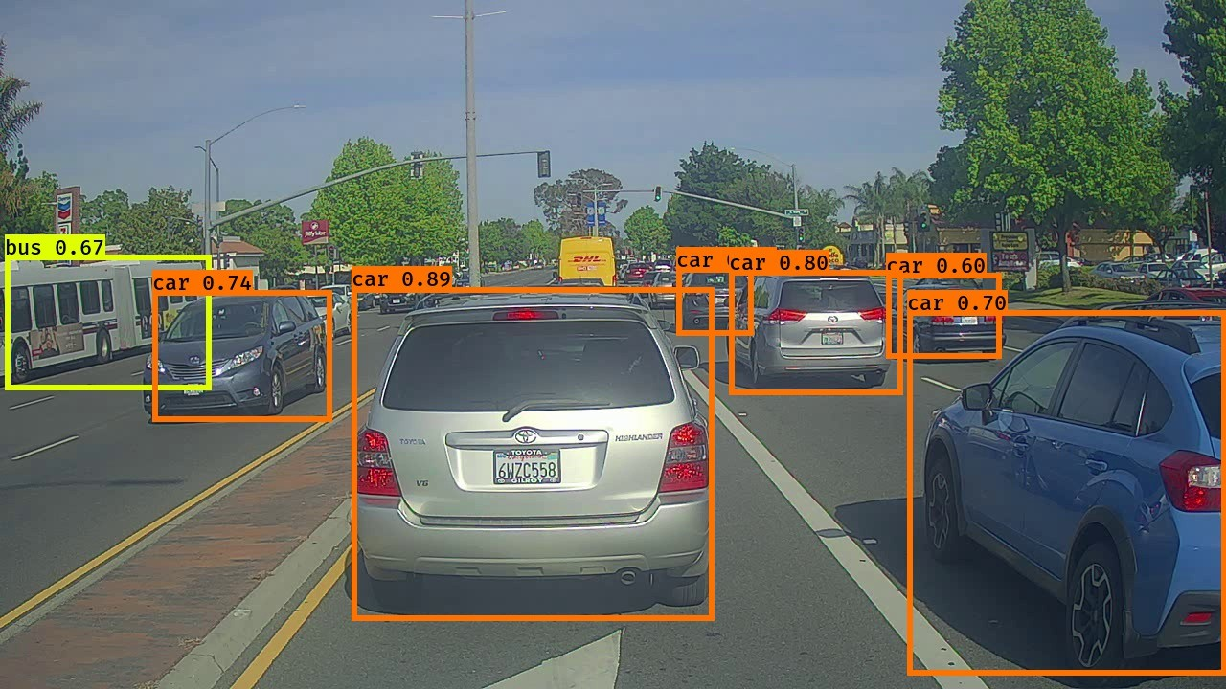
DESIGN AND METHODOLOGIES
MODULE 2:
Process of displaying output :
We have an estimated output before applying algorithm and then the data is collected and After completion of working of algorithm we will get an output.

Slide 14
STANDARDS & POLICIES
Anaconda (Python distribution)
Anaconda is a distribution of the Python and R programming languages for scientific computing (data science, machine learning applications, large-scale data processing, predictive analytics, etc.), that aims to simplify package management and deployment. The distribution includes data-science packages suitable for Windows, Linux, and macOS.
TENSORFLOW(Machine learning software library)
This standard defines a framework and architectures for machine learning in which a model is trained using encrypted data that has been aggregated from multiple sources and is processed by a trusted third party. It specifies functional components, workflows, security requirements, technical requirements, and protocols.
Open CV (computer vision library)
This standard defines deep learning based metrics of content analysis and quality of experience (QoE) assessment for visual contents, which is an extension of Standard for the Quality of Experience (QoE) and Visual-Comfort Assessments of ThreeDimensional (3D) Contents Based on Psychophysical Studies (IEEE 3333.1.1™) and Standard for the Perceptual Quality Assessment of Three Dimensional (3D) and Ultra High Definition (UHD) Contents (IEEE 3333.1.2™)

Slide 15
IMPLEMENTATION
ARCHITECTURE DIAGRAM
DATA FLOW DIAGRAM
ER DIAGRAM
SEQUENCE DIAGRAM
COLLABORATION DIAGRAM

Slide 16
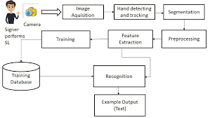
ARCHITECTURE DIAGRAM

Slide 17
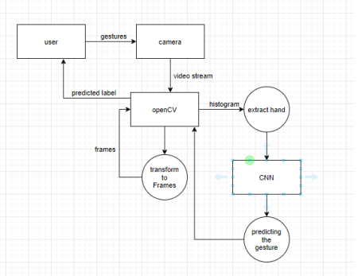
DATA FLOW DIAGRAM

Slide 18
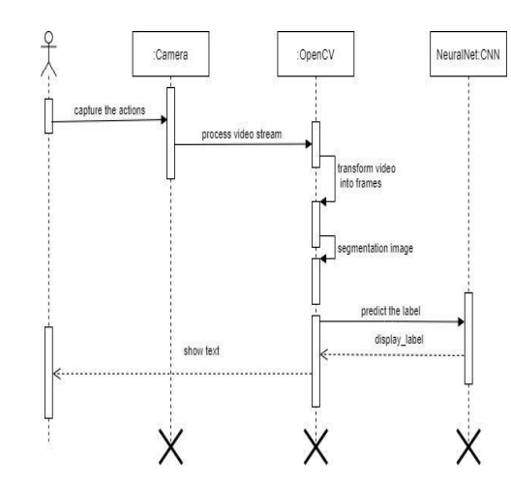
SEQUENCE DIAGRAM

Slide 19
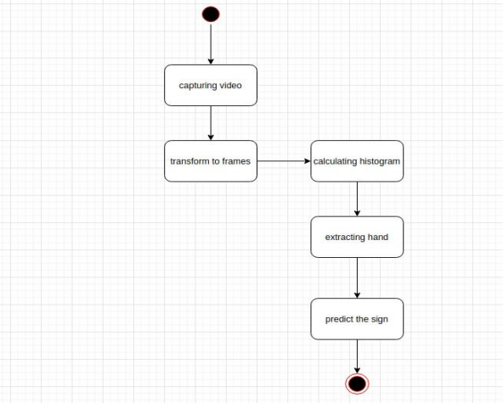
COLLABORATION DIAGRAM

Slide 20
TESTING
UNIT TESTING
Unit testing indicates the test cases planning which validates that the used programming logic is working properly or not, that program inputs produce correct outputs of 22 Validation for all the decision branches and code flow should be done. it’s the testing of individual software units of the appliance It is done after the completion of a non public unit before integration.
imprt numpy as np
X = np.array([[5,3], [10,15], [15,12], [24,10], [30,30], [85,70], [71,80], [60,78], [70,55], [80,91],])
import matplotlib.pyplot as plt
labels = range(1, 11)
plt.figure(figsize=(10, 7))
plt.subplots_adjust(bottom=0.1)
plt.scatter(X[:,0],X[:,1], label='True Position’)
for label, x, y in zip(labels, X[:, 0], X[:, 1]):
plt.annotate( label, xy=(x, y), xytext=(-3, 3), textcoords='offset points', ha='right', va='bottom’)
plt.show()

Slide 21
TESTING
INTEGRATION TESTING
After integrating the modules need to see if the combined modules work together or not. These testing is known as integration testing.
tf_example = tf.train.Example(features=tf.train.Features(feature={ 'image/height': dataset_util.int64_feature(height), 'image/width': dataset_util.int64_feature(width), 'image/filename': dataset_util.bytes_feature(filename), 'image/source_id': dataset_util.bytes_feature(filename), 'image/encoded': dataset_util.bytes_feature(encoded_jpg), 'image/format': dataset_util.bytes_feature(image_format), 'image/object/bbox/xmin': dataset_util.float_list_feature(xmins), 'image/object/bbox/xmax': dataset_util.float_list_feature(xmaxs), 'image/object/bbox/ymin': dataset_util.float_list_feature(ymins), 'image/object/bbox/ymax': dataset_util.float_list_feature(ymaxs), 'image/object/class/text': dataset_util.bytes_list_feature(classes_text), 'image/object/class/label': dataset_util.int64_list_feature(classes), })) return tf_example

Slide 22
TESTING
Functional Testing
The functions are tested by feeding them input and examining the output of the functional testing. These functional testing ensures that the requirements are properly satisfied by the application. From this types of testing is not concerned with how processing occurs, but rather with the results of processing. It simulates actual system usage but does not make any system structure assumption.
def main(_): writer = tf.python_io.TFRecordWriter(args.output_path)
path = os.path.join(args.image_dir)
examples = xml_to_csv(args.xml_dir)
grouped = split(examples, 'filename’)
for group in grouped:
tf_example = create_tf_example(group, path)
writer.write(tf_example.SerializeToString()) writer.close()
print('Successfully created the TFRecord file: {}'.format(args.output_path))
if args.csv_path is not None:
examples.to_csv(args.csv_path, index=None)
print('Successfully created the CSV file: {}'.format(args.csv_path))

Slide 23
TESTING
Black Box Testing
Testing The Black box testing is a technique that involves the checking of the applications functionality without having any technical knowledge of the application like the knowledge of the code logic how the code works knowledge of the internal structure of the black box testing.
White Box Testing
Testing White box testing is a testing method that requires a good understanding of the code. It requires great knowledge of the internal logic.

Slide 24
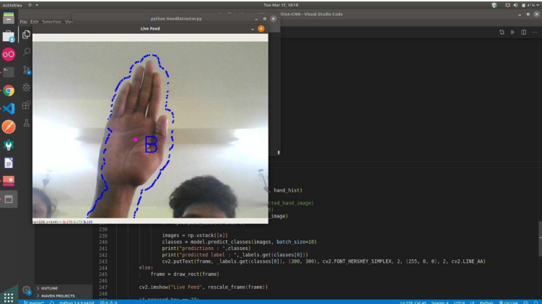
INPUT AND OUTPUT
UNIT TESTING OUTPUT

Slide 25
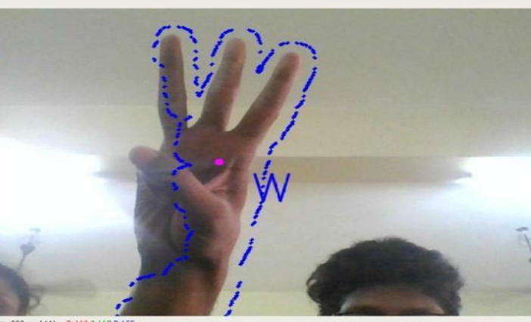
INPUT AND OUTPUT
INTEGRATION OUTPUT

Slide 26
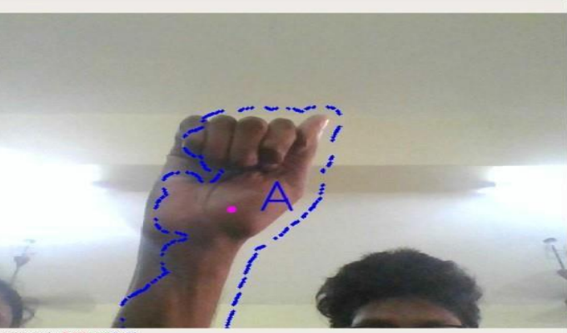
INPUT AND OUTPUT
FUNCTIONAL OUTPUT

Slide 27
DEMO VIDEO
YOU TUBE URL:

Slide 28
CONCLUSION
Nowadays, applications need several kinds of images as sources of information for elucidation and analysis. Several features are to be extracted so as to perform vari- ous applications. When an image is transformed from one form to another such as digitizing, scanning, and communicating, storing, etc. degradation occurs. Image then undergoes feature extraction using various methods to make the image more readable by the computer.Sign language recognition system is a powerful tool to prepare an expert knowledge, edge detectand the combination of inaccurate information from different sources. Intend of convolution neural network is to get the appropriate classification.

Slide 29
FUTURE ENHANCEMENTS
The proposed sign language recognition system used to recognize sign language letters can be further extended to recognize gestures facial expressions. Instead of displaying letter labels it will be more appropriate to display sentences as more appropriate translation of language. This also increases readability. The scope of different sign languages can be increased. More training data can be added to detect the letter with more accuracy. This project can further be extended to convert the signs to speech. In the experiment, we conducted 4-fold cross-validation on the system where 600 and 200 images from a subject were used to train and test, respectively and the 27 results showed that the average recognition rates of the seven gesture types were around 99 percent. To test the proposed method on multiple subjects, we trained and tested the hand images of the seven gesture types from seven subjects. The average recognition rate was 95.96 percent. The proposed system also had the satisfactory results on the transitive gestures in a continuous motion using the proposed rules. In the future ,a high-level semantic analysis will be applied to the current system to enhance the recognition capability for complex future works.

Slide 30
Web references/video links
http://cs231n.stanford.edu/reports/2016/pdfs/214_Report.pdf
http://www.iosrjen.org/Papers/vol3_issue2%20(part-2)/H03224551.pdf
http://citeseerx.ist.psu.edu/viewdoc/download?doi=10.1.1.734.8389&rep=rep1&typ
http://citeseerx.ist.psu.edu/viewdoc/download?doi=10.1.1.734.8389&rep=rep1&typ e=pdf

Slide 31
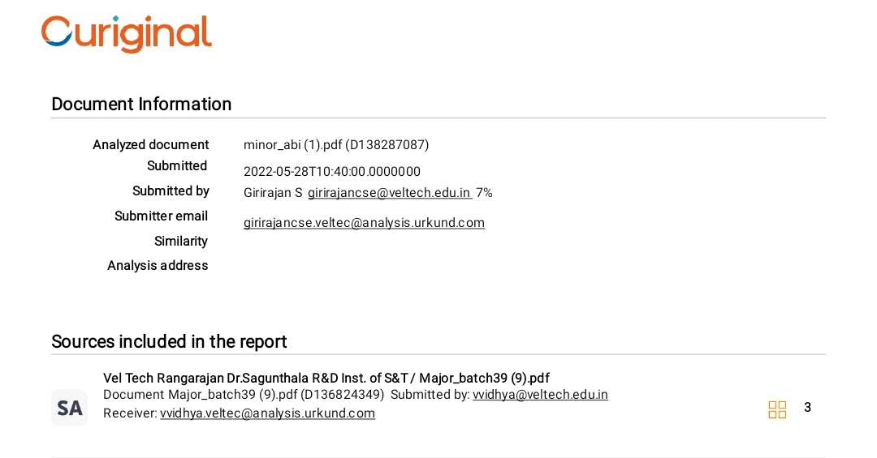
PLAGIARISM REPORT OF PPT

Slide 32
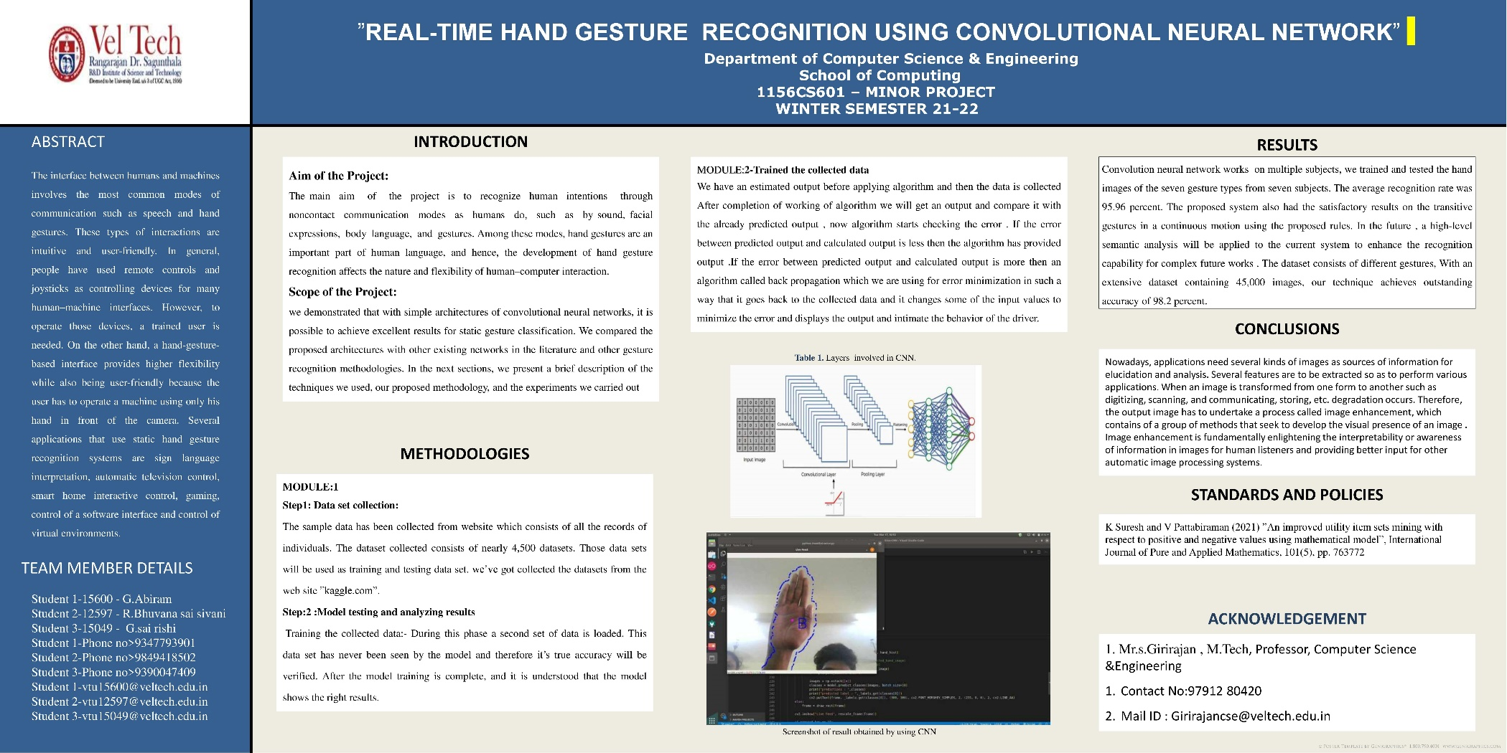
POSTER PRESENTATION

Slide 33
REFERENCES
Ankit V Ponkia and Jitendra Chaudhari(2020), ”Face Recognition Using PCAAlgorithm”, Inventi Rapid: Image Video Processing Journal, 4(1), pp. 519-524.
B J Bipin, K Nihar and C. Adarsh(2020). A Comparative Binarization Approachfor Degraded Agreement Document Image from Various Pharmacies, IEEEjournal, 12(4), pp. 806-814.
K Suresh and V Pattabiraman(2021) ”An improved utility item sets mining withrespect to positive and negative values using mathematical model”, InternationalJournal of Pure and Applied Mathematics, 101(5), pp. 763772

Slide 34
REFERENCES
MK J Khan, N Ud Din and B.S.Y. J.(2020), ”Interactive removal of microphoneobject in facial images”, Electronics, 8(10), pp.167-256.
Xu, L. Ren, Jimmy Liu, C. Jia, J.. (2021). Deep convolutional neural networkfor image deconvolution. Advances in Neural Information Processing Systems,(6)2,pp: 1790-1798

Slide 35
THANK YOU

